Slide 1
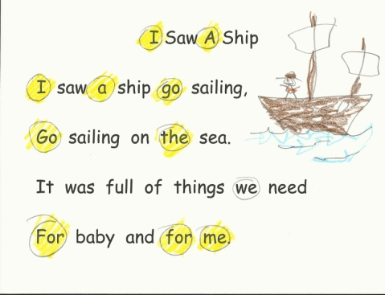
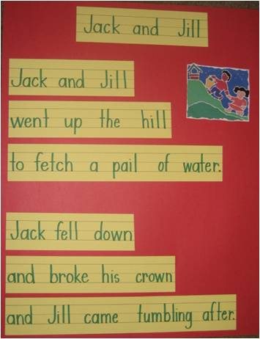
Bath County Workshop
July 29, 2013
Cathy Collier

Slide 2
6 Samples ~
Decide which of the following samples are from kindergarten and which are from 1st grade.

Slide 3
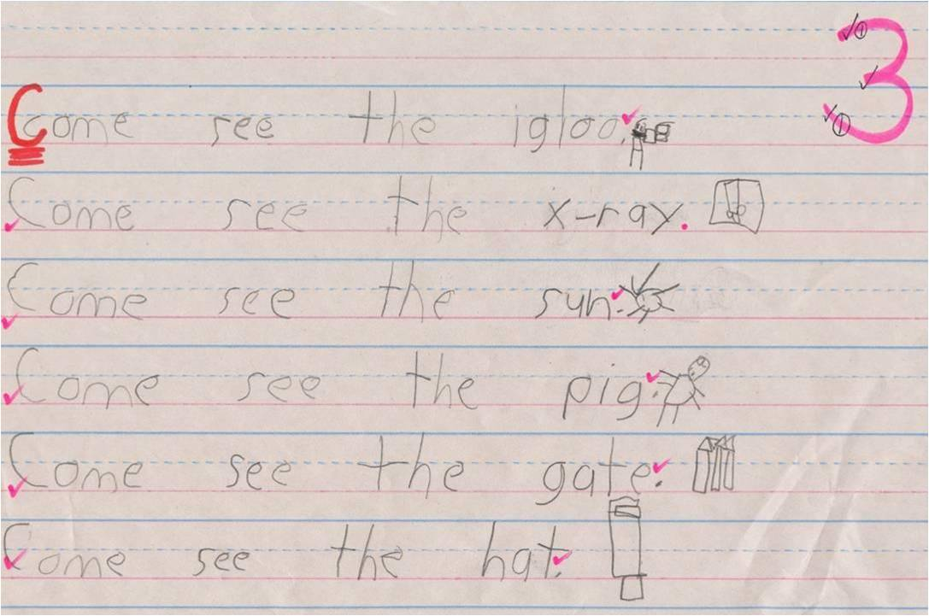
1

Slide 4
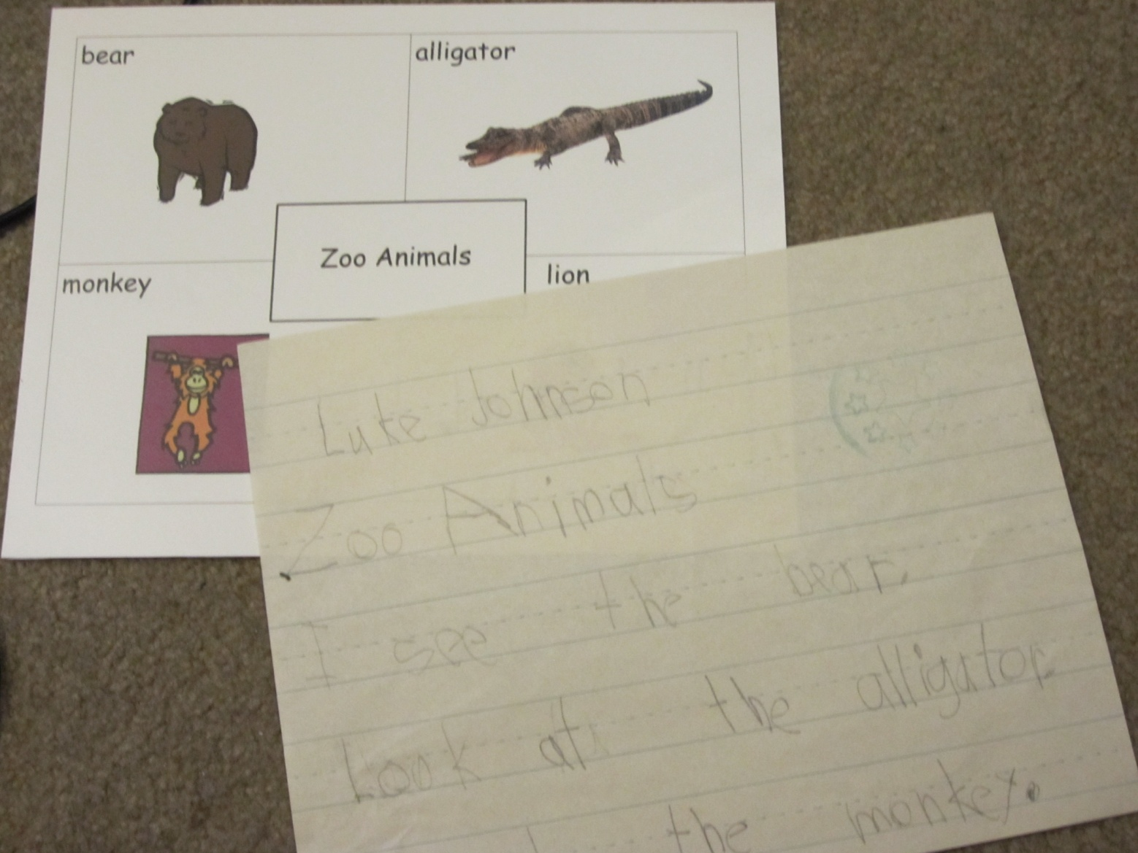
2

Slide 5
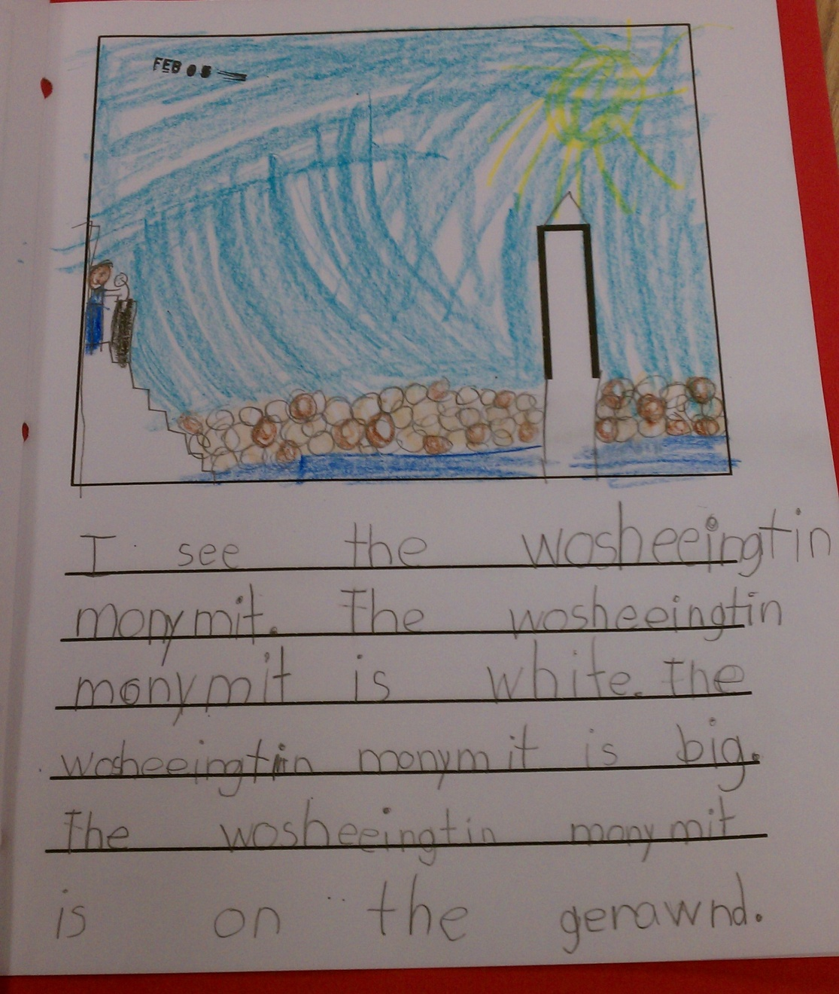
3

Slide 6
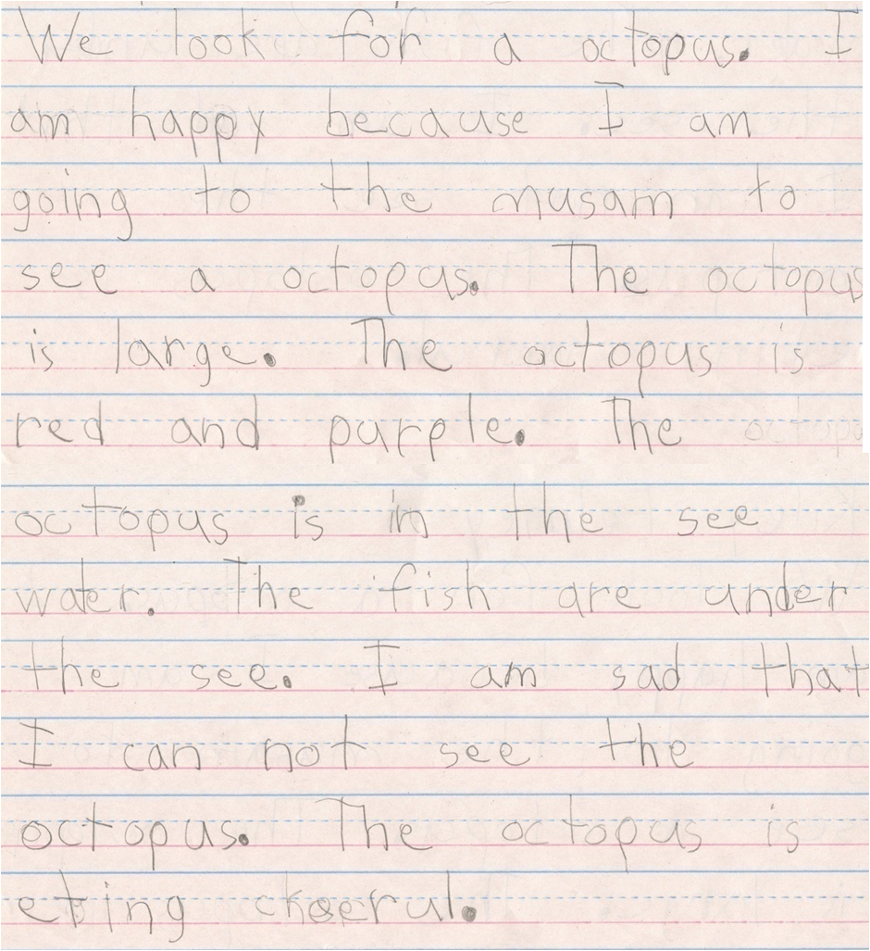
4

Slide 7
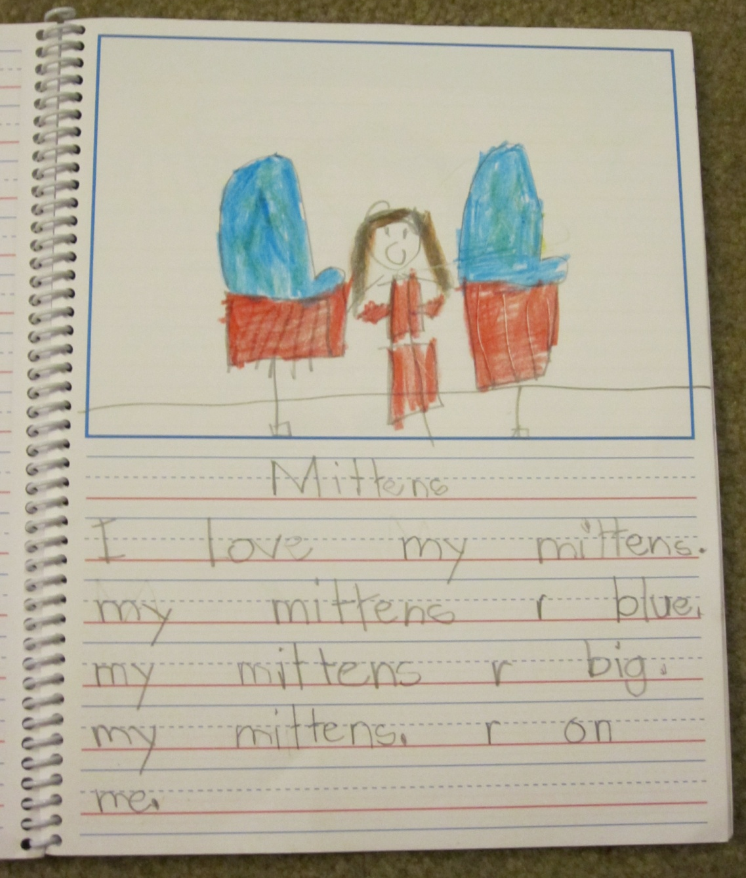
5

Slide 8
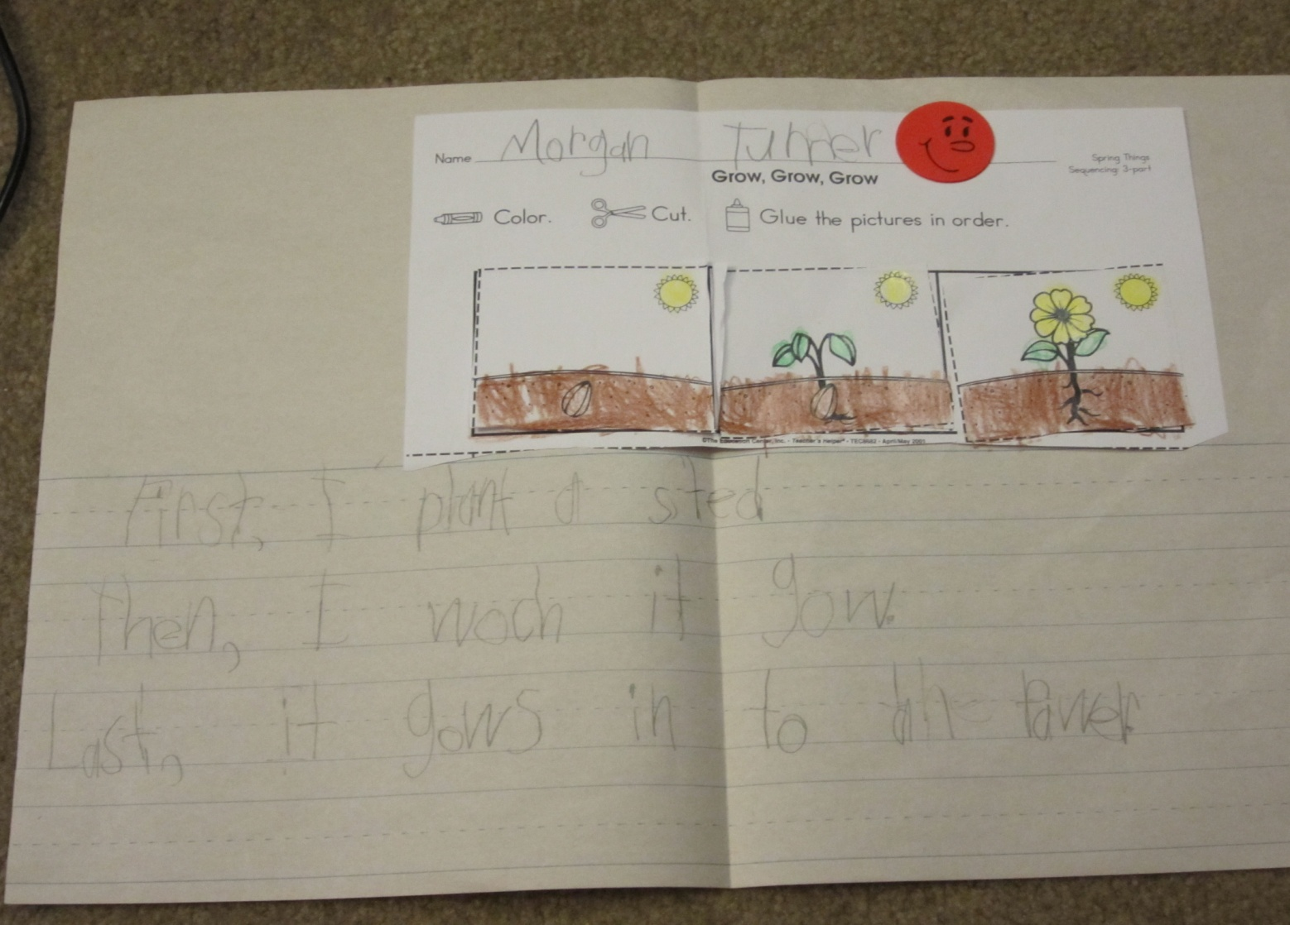
6

Slide 9
Never confuse motion with action.
~Ben Franklin
Notes:
We tend to be busy. Very busy…but, are we actually doing anything. Don’t be busy, being busy. Choose actions that move you forward.

Slide 10
What do you want to get done?
Routines: need them
Reading: need it…lots of it
Writing: need it…lots of it
Word wall words: need them
Ideas…
Pacing

Slide 11
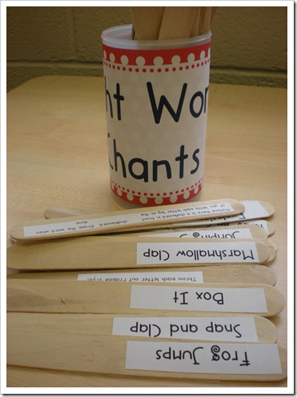
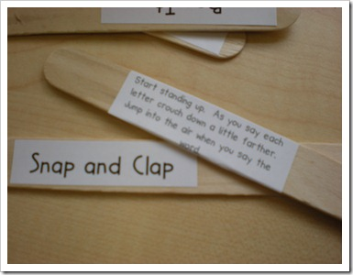
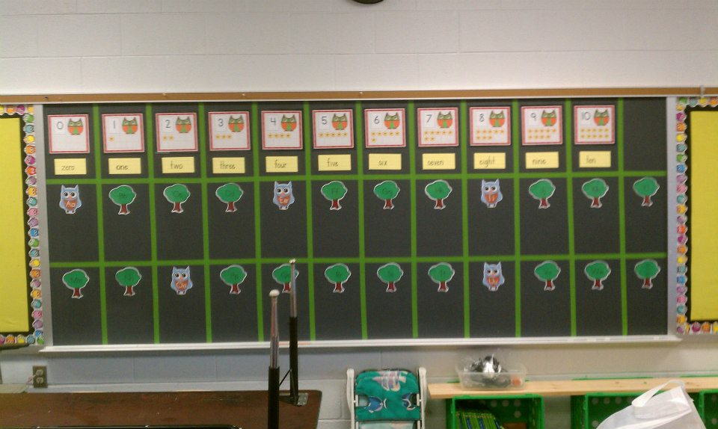
Word Wall Words (WWW) ~
11 words a 9 weeks
2 a week for 5 weeks/1 in week 6
Review weeks 7-9
Add during calendar time
Choose a popsicle stick activity
Write in WWW center in isolation
Use in Interactive Writing sentences
www.growingkinders.blogspot.com

Slide 12
Writing ~ Kindergarten
1st 9 weeks –
Predictable Texts
Whole Group Interactive Writing – weekly stories
Centers - Word Wall Words ~ Fab 5
2nd 9 weeks –
Predictable Sentences with the Big 3
Whole Group Interactive Writing – weekly stories
Centers – squiggles ~ Give Me 3 ~ 4 square
3rd 9 weeks –
Independent Stories
Centers – First/Then/Last ~ Word Families
4th 9 weeks –
Independent Stories
Centers -

Slide 13
Centers ~
Starting from the 2nd Week!
Teach process – change product
Teach Independence
Teach Routine for EVERYTHING!
MORE TO COME – AFTER LUNCH!

Slide 14
Shared Reading ~
Starting from the 1st day!
Poems should be 4-6 lines in length
Teach process – change product
1-2-1 Match
Word Wall Words
Centers
Poetry/Art Center the 2nd week
Pocket Chart the 3rd week

Slide 15
Well done is better than well said.
~Ben Franklin
Notes:
We tend to be busy. Very busy…but, are we actually doing anything. Don’t be busy, being busy. Choose actions that move you forward.

Slide 16
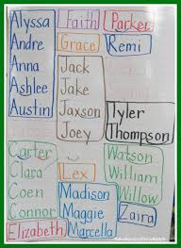
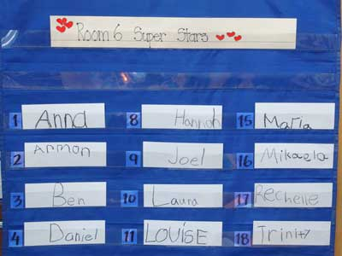
Start with Names…Day 1
Make a name chart. Know you’re student list and prepare before…know their names in alphabetical order. Start with A…and invite the students to write their first letter…you finish it.
Writing

Slide 17
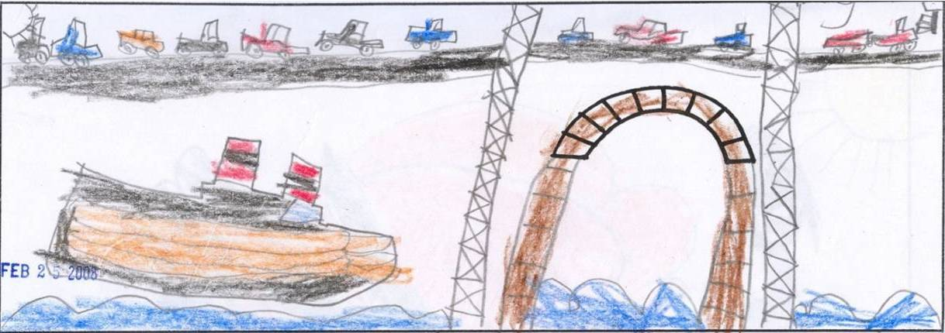
Writing ~ Continue with names.
Give models for writing and let them write their names in fun, funky ways.
Write with dry erase boards, markers, pencils, colored pencils, highlighters. Do not let them write with crayons. Crayons are for decorating…not writing, not drawing. Your illustrations will be better if they learn from the beginning to draw details with their pencils and decorate with their crayons.

Slide 18
 | Write it with a pencil. | Write it with a marker. | Write it with a colored pencil. | Write it with a highlighter.
Austin
Austin
Austin
Austin
Austin
Austin
Austin
Austin

Slide 19
Writing ~
Continue process...change product!
 | Write it with a pencil. | Write it with a marker. | Write it with a colored pencil. | Write it with a highlighter.
at
see
we
can
to
the
look
me

Slide 20
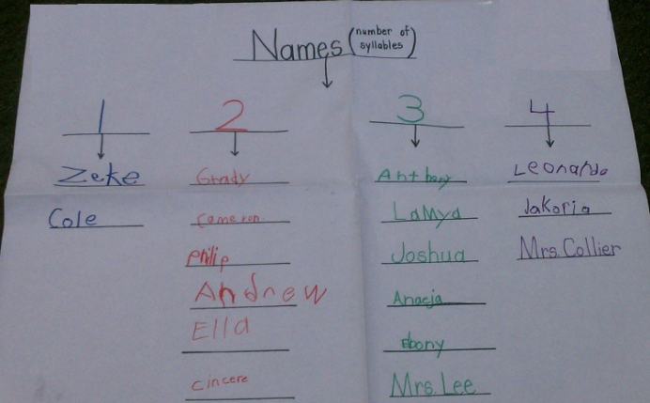
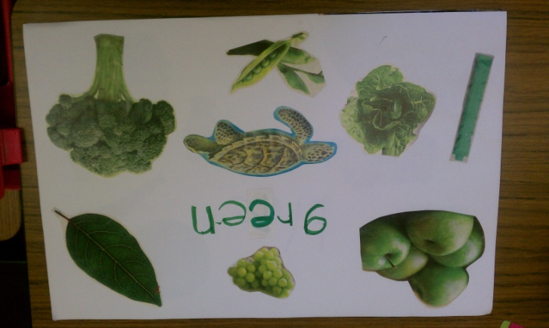
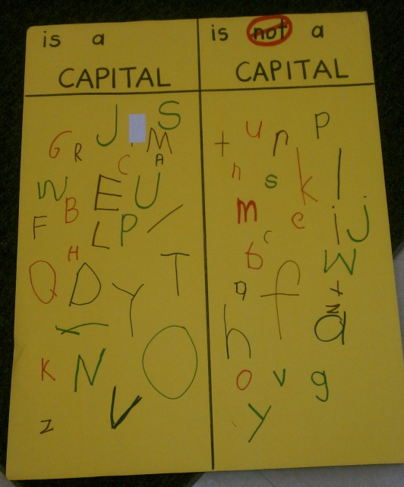
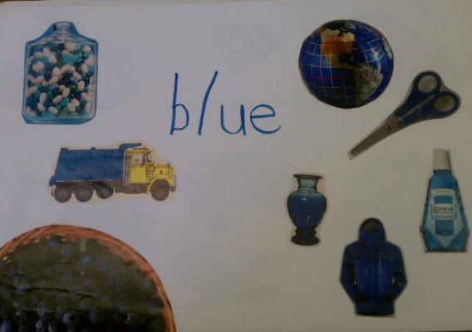
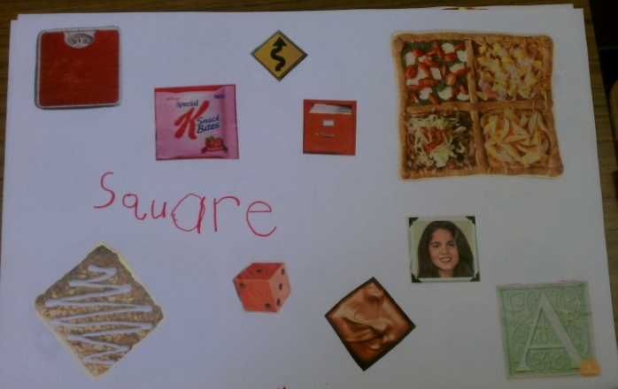
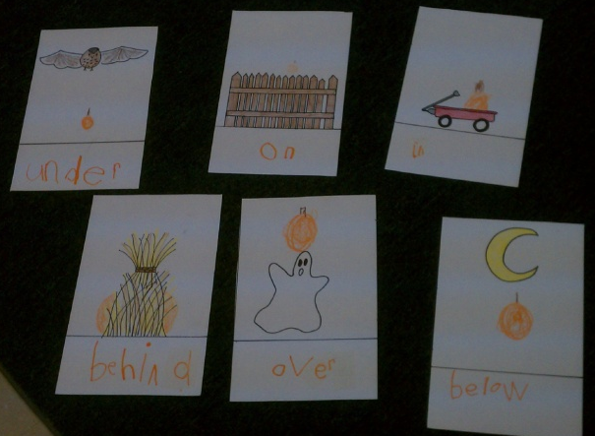
Label the Room with Anchor Charts
Notes:
I am a fanatic about magazines…ask around for “old” lady magazines…

Slide 21
From the beginning, give oral directions for writing. Talk about tall letters, short letters, and hang down letters. Talk about the three lines…you choose…sky line, tree line, grass line, and dirt line.
Even before you give them lines, talk about lines.
First 9 weeks = no line or bottom line
Second 9 weeks = I use lines
Third 9 weeks = Smaller lines
Fourth 9 weeks = Smaller lines
Write with dry erase boards, markers, pencils, colored pencils, highlighters.
Penmanship
Notes:
An early exercise for writing with lines…give students a piece of paper with 3 folded lines and 3 different color bears or manipulatives. Give the students oral directions…
“…put the green bear on the top line, put the red bear on the bottom line, put the yellow bear on the middle line.”
Another day, give them markers or colored pencils and oral directions…
“…take the green crayon and draw a line from the top to the bottom.”

Slide 22
What do you need to start?
Need to be routine!
Need something to take the fear out of writing.
Need something to encourage independence in writing.
Need something that can be offered and used as a tool for letting their creativity move forward.
Need something that can be maintained easily.
Need something that can be monitored easily.

Slide 23
It all begins with Reading!
As early as the third week of school, show your students that word wall words can make sentences. Using word wall words and the pictures from the Fountas and Pinnell sound chart, we read sentences daily…
I see the .
I see the .
Make sure you mention the 3 big things we see in a sentence (capitals at the beginning, spaces in the middle, and a period at the end).
© Collier 2008

Slide 24
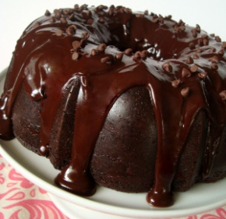
Start with Whole Group Interactive writing!
I made a big Sentence Maker ©
I explain the routine to the students.
Starting week 2, using a topic suggested by a mentor text…
Monday: Write a title and a www sentence.
Tuesday: Write a color sentence.
Wednesday: Write a size sentence.
Thursday: Write a setting sentence.
Friday: Illustrate.
© Collier 2008
Notes:
“Have you ever seen a delicious chocolate cake? Have you ever wanted to eat it all? Do you think I’ll be able to eat the whole cake in one day? I should probably eat a little at a time, right? Well, this week we are going to write our very first story. But, we can’t write the whole thing today, can we? Let’s write one sentence a day…and we’ll be done by the end of the week. We can do that.”

Slide 25
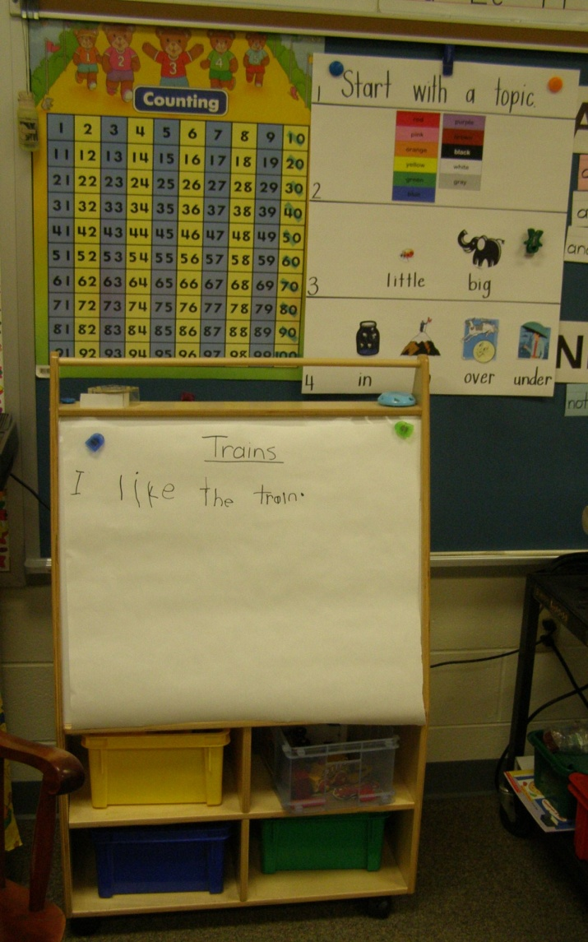
Gather your writing for materials
Hand ~ paper ~ pen ~ spacer
Orally decide on a sentence.
Count ~ write ~ spacer
Count ~ fold & whisper ~ write ~ spacer.
Count ~ fold & whisper ~ write ~ spacer.
When you are done: your hand is fisted…what do we need on the end? A period.

Slide 26
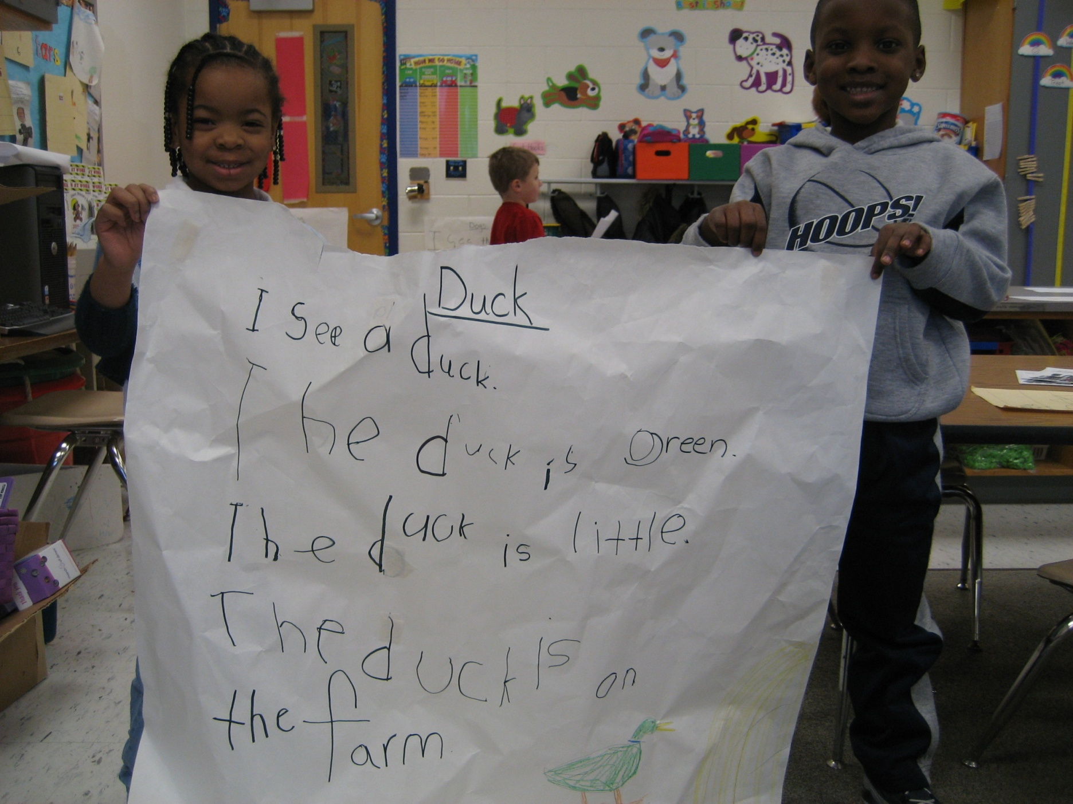
Writing ~ The Sentence Maker ©!

Slide 27
Writing ~ The BIG 3!
After each sentence, talk about the BIG 3.
Capitals at the beginning…you can tell them about names and capitals, but you won’t add names into their stories.
Spaces in between. Hold up your fingers…spaces in between.
A period at the end…tell them there are more ways to end a sentence, but we’ll start with a period.
Make a class poster of the BIG 3. Talk about the BIG 3 every day.
Writing a sentence is easy as can be.
All you need is the BIG 3.
Start with a capital,
and spaces in between.
End with a period…you know what I mean.
Writing a sentence is easy as can be.
All you need is the BIG 3!

Slide 28
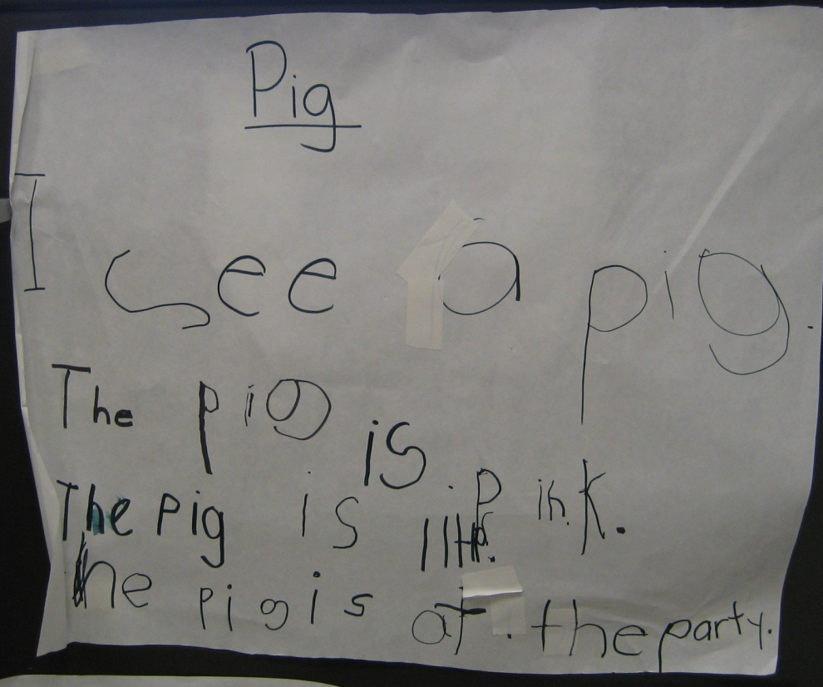
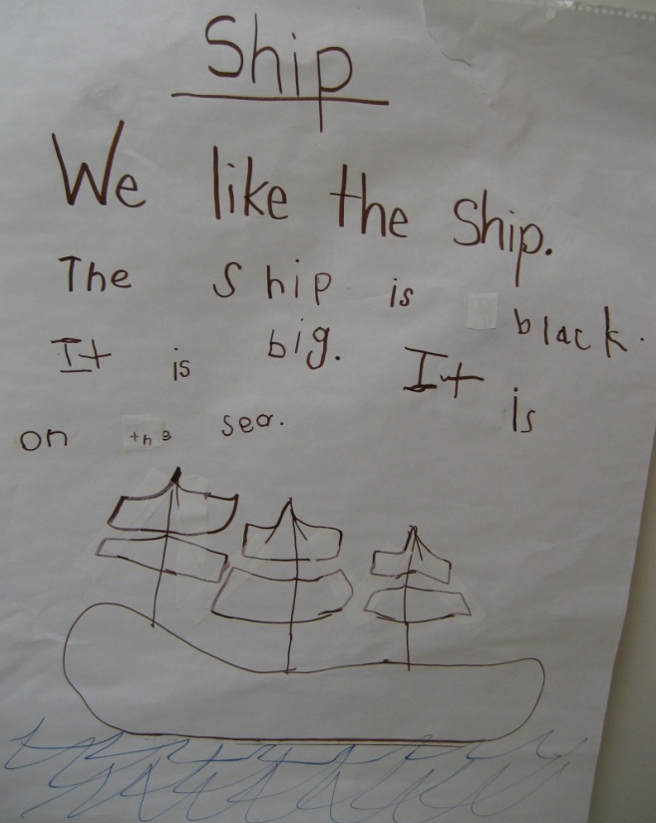
The Sentence Maker ©!
Continue with The Sentence Maker © weekly.
Introduce students to exchanging pronouns for the topic.
Choose topics that relate to relevant SOLs.

Slide 29
Practice Independent Writing!
In a WWW Center...
Students need to be practicing with independent writing…predictable sentences are the perfect way to do this.
Talk about the BIG 3.
Use the sound chart to write sentences…so the focus is on the writing process, not the spelling.

Slide 30
Independent Story Writing
Students are asked to choose a topic (topic cards, ABC books, word cards)
Students follow their Sentence Maker ©.
When they are done, the completed story goes in the back pocket of their writing folder.
When they have 4 stories in their folder…they can publish!
When they are done, the students must read the story to you.
You check with the BIG 3.
When they are done, can add the story to their back pocket.

Slide 31
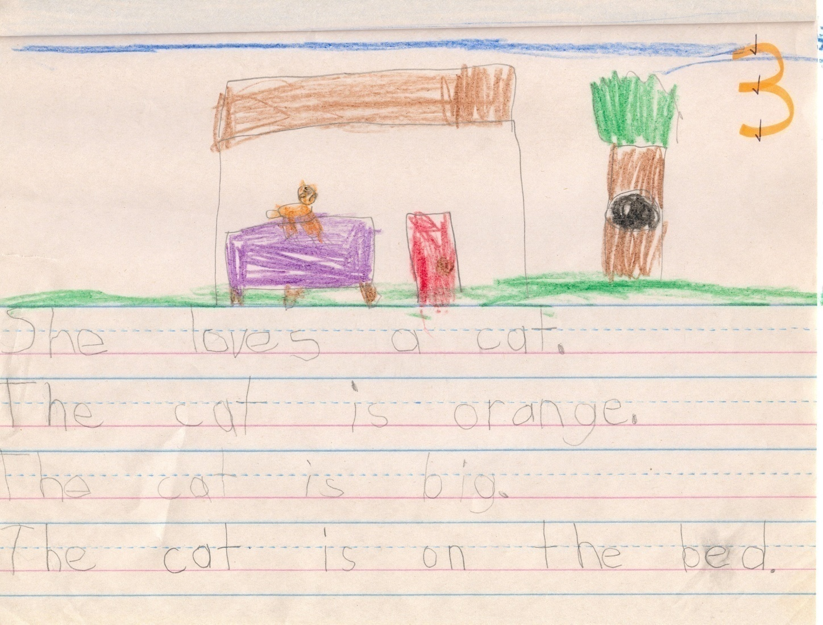

Slide 32
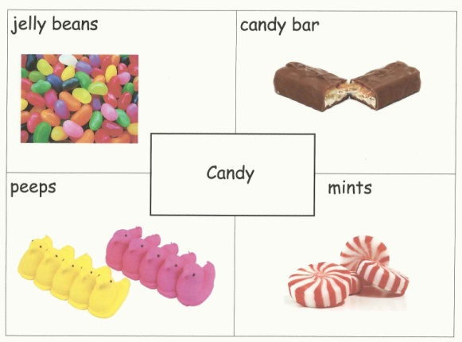
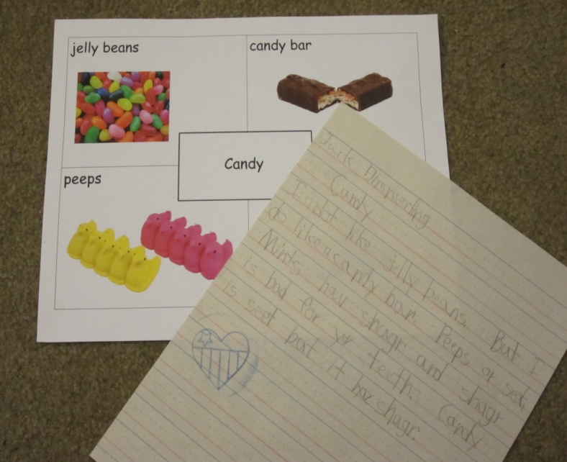
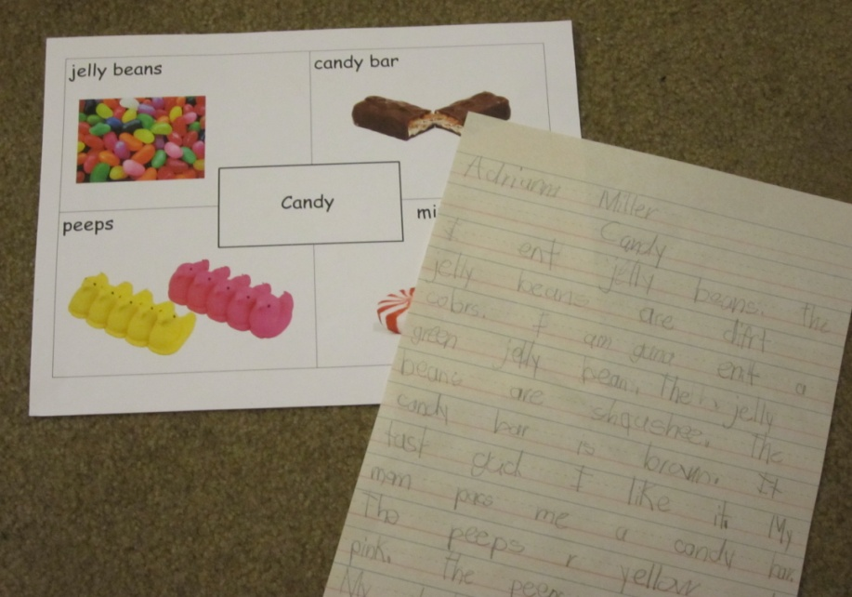
Another Writing ~ Independent Story Writing
The Good Old 4-Square
Start with programmed 4-Squares.
Always talk about the title as the main
topic.
Always teach left-to-right, top-to-bottom.

Slide 33
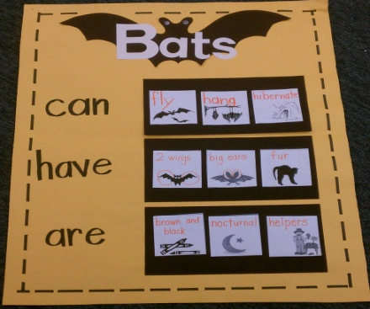
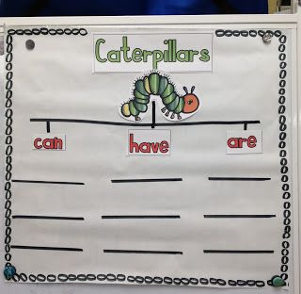
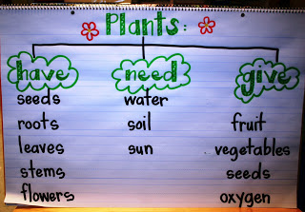
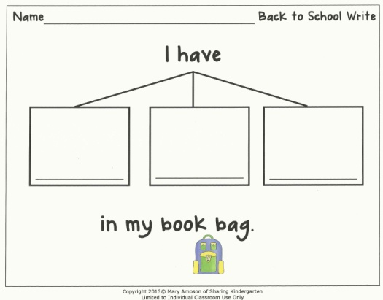
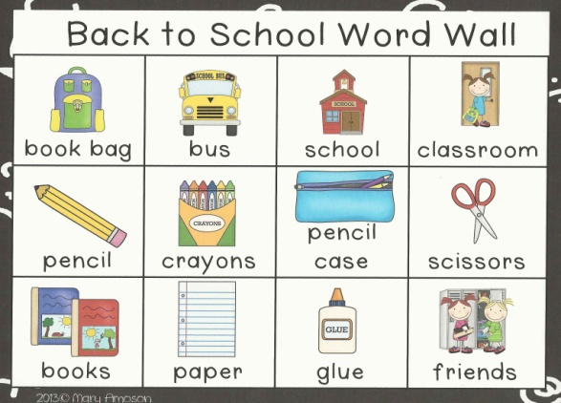
Another Writing ~ Independent Story Writing
The Can/Have/Are or Is/Can/Likes www.inspiredapple.blogspot.com
Teach the process…and they can create the product.
Write Me Three ~ www.sharingkindergarten.com
Teach the process…and they can create the product

Slide 34
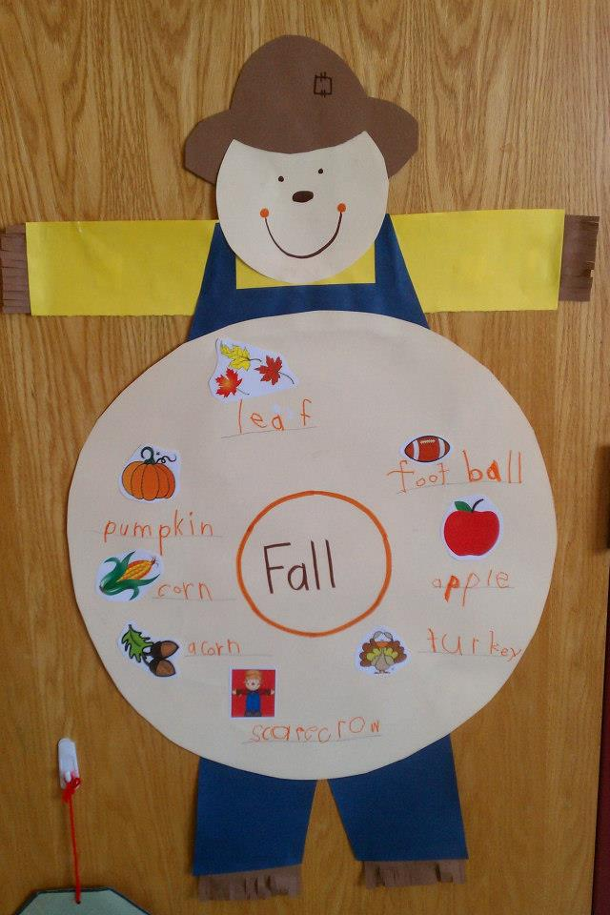
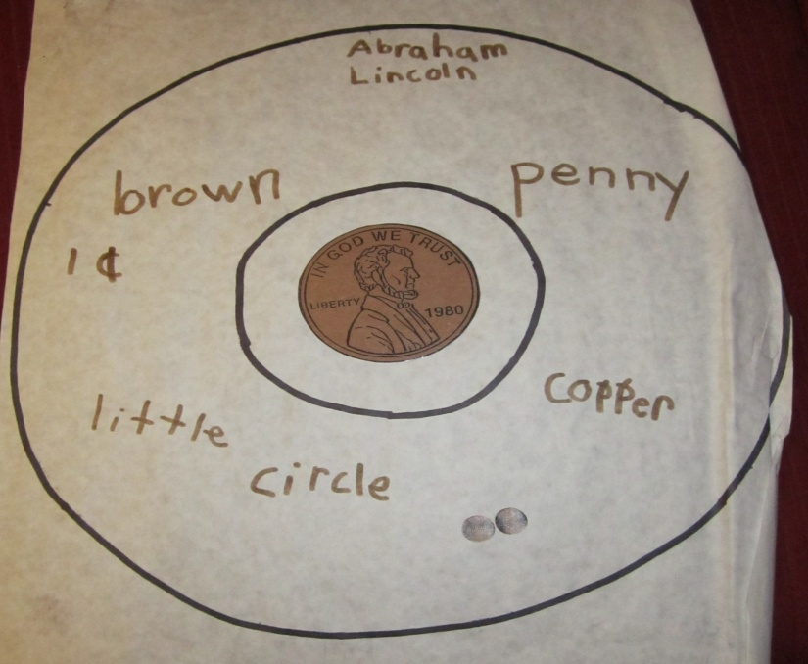
Thinking Maps…
A map is a PRE-WRITE! There must be authentic writing that follows.
Circle Map: For defining context…

Slide 35
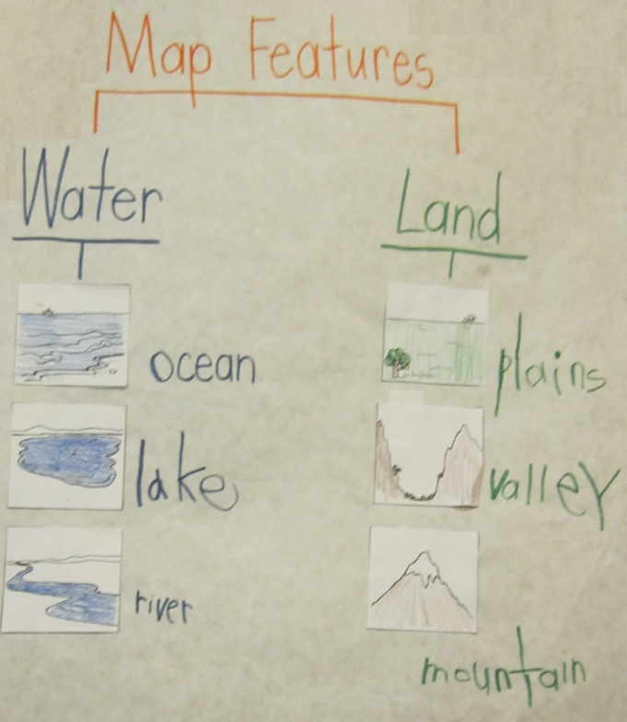
Thinking Maps…
Tree Map: For classifying and grouping…

Slide 36
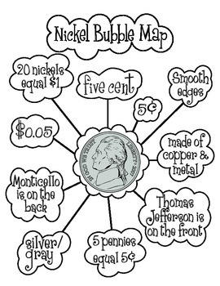
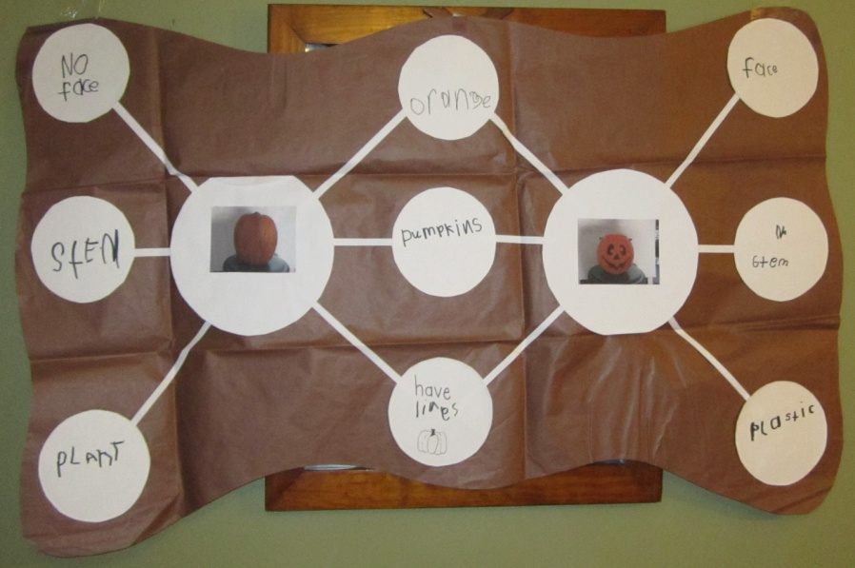
Thinking Maps…
Bubble Map: For describing using adjectives…
Double Bubble Map: For comparing and constrasting…
My favorite is
penny v. nickel

Slide 37
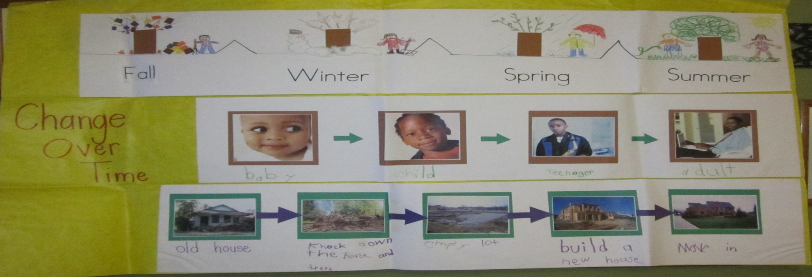
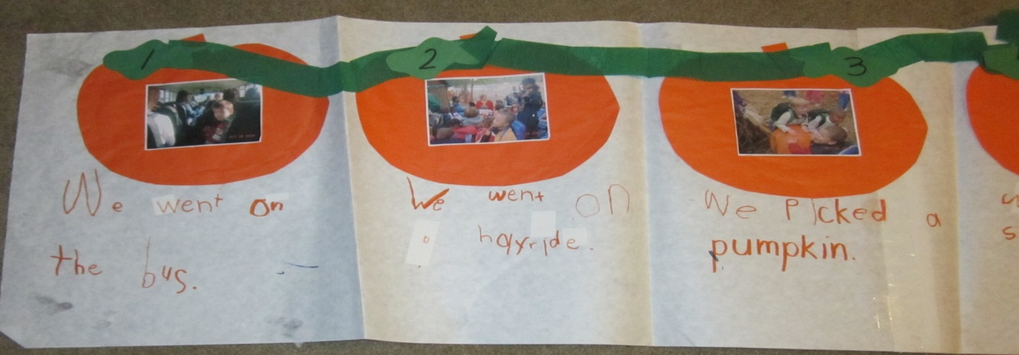
Thinking Maps…
Flow Map: For sequencing and ordering…

Slide 38
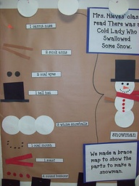
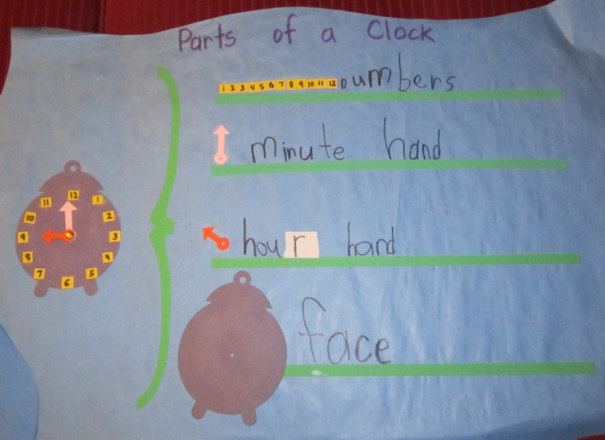
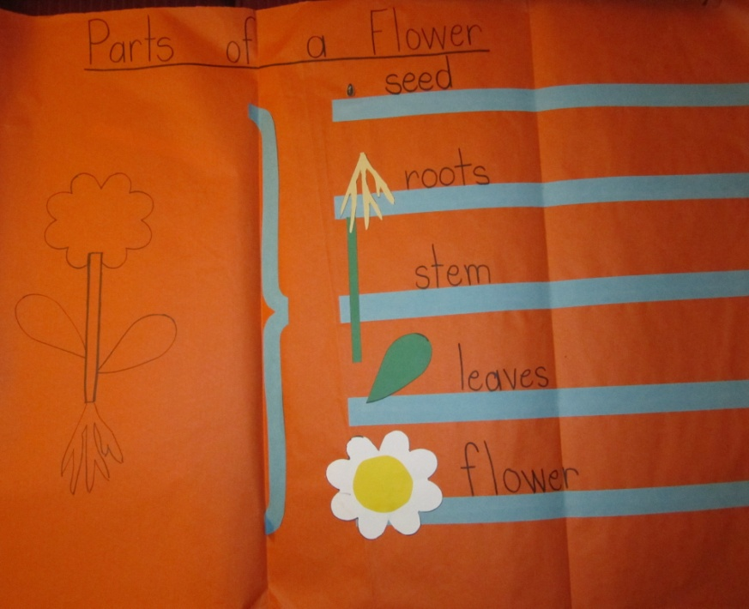
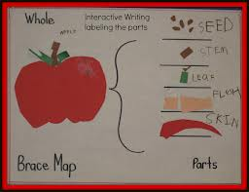
Thinking Maps…
Brace Map: For analyzing whole objects and parts…

Slide 39
Thinking Maps…
Bridge Map: For seeing analogies…

Slide 40
Where do you keep their writing?
1. Writing Folders
Welcome Back...
Students are given new Writer’s Workshop folders.
In the folders, you should have
individual Sentence Makers ©
Fountas and Pinnell Sound Charts
Create a student-made BIG 3
The front pocket should be labeled…Rough Draft
The back pocket should be labeled…To Be Published
As you start the month, you write the story on the board/document camera/overhead, while they write on paper. Write one sentence a day.

Slide 41
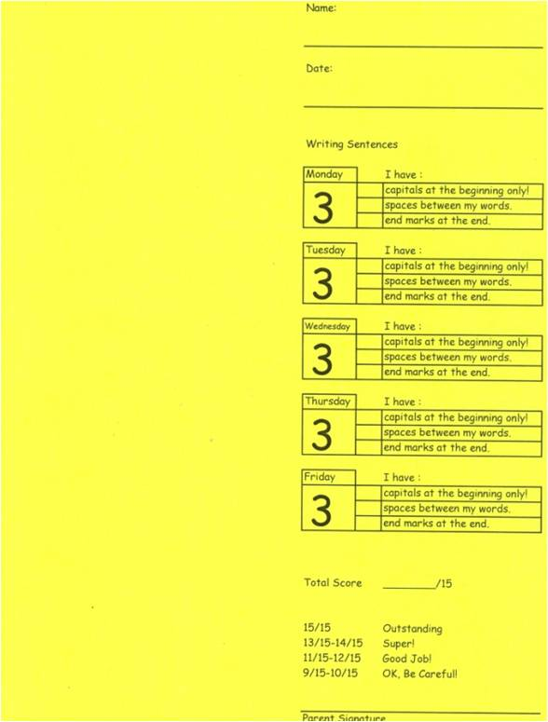
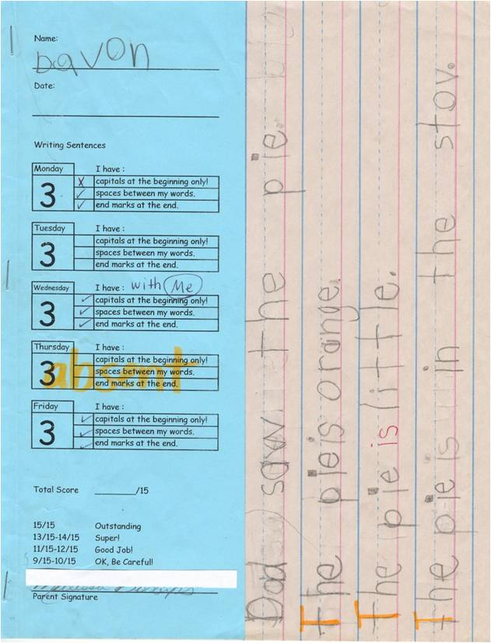
Where do you keep their writing?
2. Weekly Writing with Rubric

Slide 42
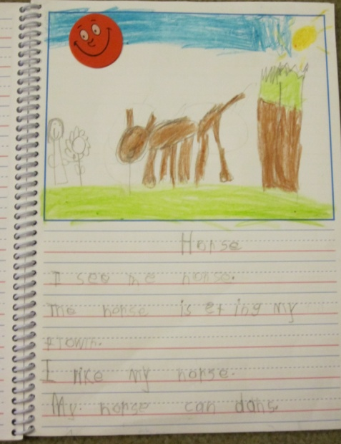
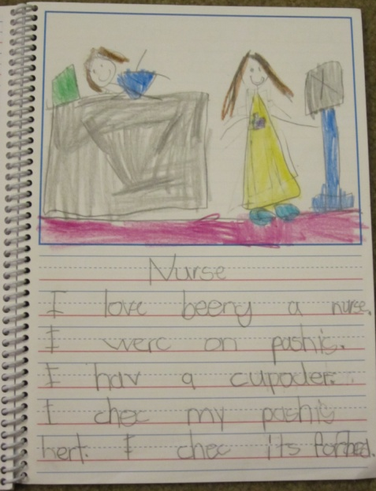
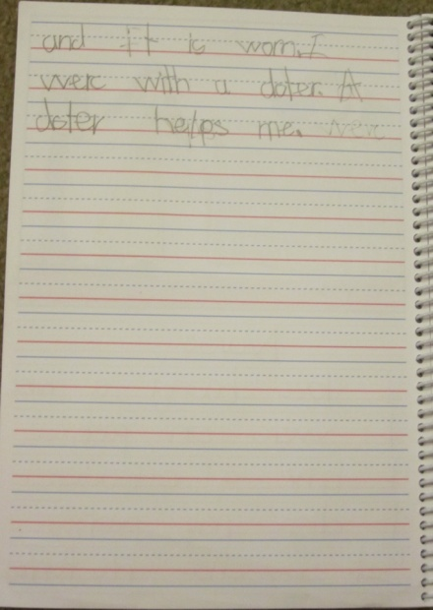
Where do you keep their writing?
3. Journal
The Good Old Journal
Ordered journals from Really Good Stuff (Donors Choose)
Allow for topics
Scheduled journal time

Slide 43
When do you do writing?
ALL DAY
Morning Work – at least 3 days a week…practice writing
Calendar Time
English Lesson – syllables, digraphs, etc.
Centers –
Writing
4 Square
First, Then, Last
Squiggles
Word Family
Math
Science/Social Studies
Listening Center
ABC Center
Fab 5
Science/Social Studies
Math

Slide 44
To succeed, jump as quickly at opportunities as you do at conclusions.
~Ben Franklin
Notes:
We tend to be busy. Very busy…but, are we actually doing anything. Don’t be busy, being busy. Choose actions that move you forward.

